Slide 1



Control Valve Assembly Maintenance Recommendations
Fisher™ FIELDVUE™ Instruments
Click to begin

Slide 2
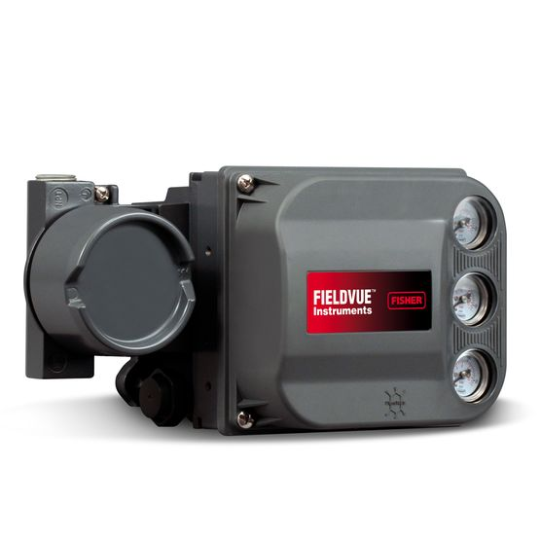



You’ve invested in FisherTM FIELDVUETM instruments for access to diagnostic capabilities that enable enhanced valve maintenance guidance. Typical company processes recommend performing an open and inspect every three to five years, disregarding your long-term investment in diagnostic capabilities.
CHALLENGES
!
Maintenance Practice
Investment
Cost
Your latest diagnostic instrument scan indicates your valves are meeting operational requirements.
Your preventative maintenance practice may preclude you from leveraging diagnostic equipment, forcing an
open and inspect of a
control valve.
Disassembling control valves that are meeting operational requirements
utilizes valuable
resources and adds
unnecessary costs.

Slide 3
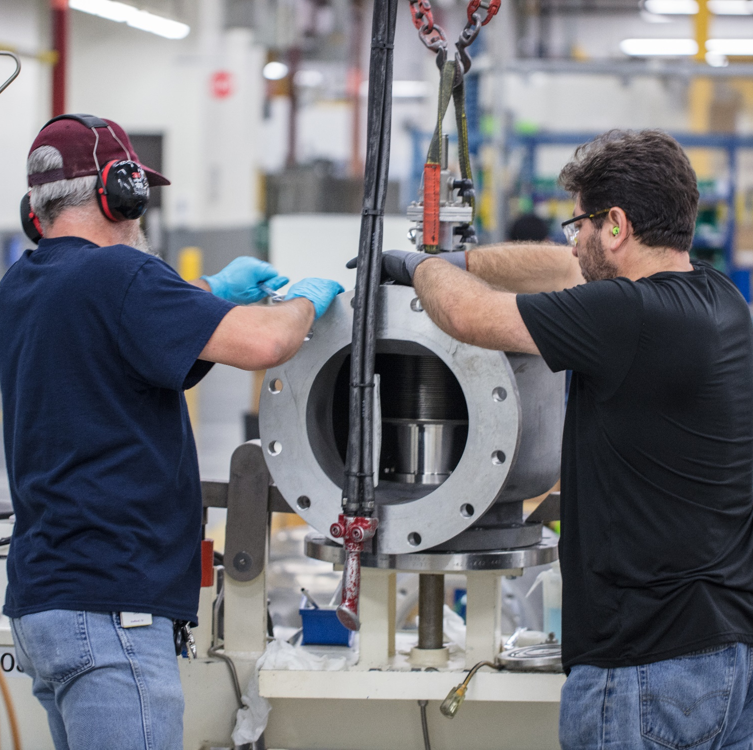


Emerson offers global expertise and support in updating your maintenance processes and practices.
YOUR OPPORTUNITY
!
Maintenance Practice
Investment
Cost
Emerson’s technology and experts can help maximize your instruments’ diagnostics capabilities in preparation for your next maintenance event.
Work with Emerson
experts to take advantage
of diagnostics to
improve your existing
maintenance practices.
Disassembling
control valves adds
unnecessary cost and
valuable recourses.

Slide 4




Maintenance Guides provide recommended actions based on plant criticality, process conditions and our control valve expertise
In addition to plant criticality, careful consideration should be given to whether control valve application is general or severe service.
!
1.
Critical Functions — Mission Critical
Significantly impacts plant performance directly affecting operations and may cause the plant to be shut down until the issue is resolved.
2.
Essential Functions — Vital
Moderate to Significant impact on plant operations.
3.
Necessary Functions — Important
Mild risk of operational impact.
4.
Desirable Functions — Minor
Ancillary applications with almost no impact to operations.

Slide 5
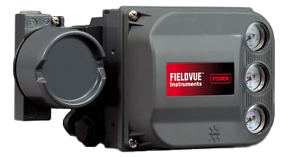
Control Valve Assembly Maintenance Recommendations Guide for Mission Critical or Vital Criticality
Control Valves with Fisher™ FIELDVUE™ Instruments
Maintenance Interval
Assembly Visual Inspection Recommendation
Diagnostics Recommendation
Run Off-Line diagnostics during outages
Open and inspect only upon diagnostic findings that recommend such action (valve signature, step response, travel deviation, drive signal, performance diagnostic indicators)
Perform general inspection to identify obvious damage or issues that may impact control or safety on a systematic basis
Set-up Performance Diagnostics PD Triggered Profile
Recommend utilization of the Emerson Valve Condition Monitoring Program or Valve Health Insight
Monitor condition of body and bonnet for wear; consider replacement over time
Predictive Maintenance
Loose and broken bracketry including position feedback connections
Air leaks in tubing and fittings
Leakage between bonnet and body, packing and stem, flanges, broken hardware
Vibration related damage
Broken FIELDVUE covers and broken gauges
Inspect wiring including junction boxes
Compromised insulation
  Review instrument alert log for potential instrument or valve assembly issues
  Review control system log of performance abnormalities
  Perform valve signature/step response and observe for high cycle count, travel deviation alerts, I/P (current-to-pressure transducer) drive signal alerts, seat profile, air leaks, spring rate
  Perform and review Performance Diagnostics (PD)
  Perform leakage test
  Consider your spare part planning using table on page 10
Every 1 - 3 Years

Slide 6
Control Valve Assembly Maintenance Recommendations Guide for Mission Critical or Vital Criticality
Control Valve without Fisher™ FIELDVUE™ Instruments
Maintenance Interval
Assembly Visual Inspection Recommendation
Periodic
Maintenance
Monitor condition of body and bonnet for deterioration;
consider replacement over time
Perform visual inspection
Loose and broken bracketry including position feedback connections
Air leaks in tubing and fittings
Leakage in between bonnet and body, packing and stem, flanges, broken hardware
Consider having recommended spare parts for replacement using table on page 10
During outages, perform valve diagnostics using Fisher QUIKLOOK 3-FS with FlowScannerTM Software
Every 1 - 3 Years
Perform visual inspection
Complete an open and inspection of the valve utilizing new soft goods Complete valve repair utilizing recommended spare parts
Perform general inspection identifying obvious damage or issues that impact control or safety on a systematic basis
Be prepared to replace trim if severe service application
Perform Pre and Post valve repair diagnostics using Fisher QUIKLOOK 3-FS with
FlowScanner Software
Every 3 - 5 Years
Open and Inspect Event

Slide 7
Control Valve Assembly Maintenance Recommendations Guide for Important or Minor Criticality
Control Valve with Fisher™ FIELDVUE™ Instruments
Maintenance Interval
Assembly Visual Inspection Recommendation
Diagnostics Recommendation
Open and inspect only upon diagnostic findings that would recommend such action (valve signature, step response, travel deviation, drive signal, Performance Diagnostic indicators).
Consider running off-line diagnostics during outages
Enable 3 key alerts: travel deviation, supply pressure, and drive signal. Enable other alerts as needed based on the
specific application
Preserve information by enabling the alert record and setting up the triggered profile
Routinely monitor and review the alert record for new alerts.
Create and follow an action plan based on the alerts received
Periodic Maintenance
              Loose and broken bracketry including position feedback connections
              Air leaks in tubing and fittings
              Leakage in between bonnet and body, packing and stem, flanges, broken hardware
              Process leakage between body and pipe flange
              Inspect wiring including junction boxes
  Perform leakage test
  Review control system log of performance abnormalities
  Perform dynamic scan and observe seat load, friction, spring rate, and air supply
  Run a step response and observe the response of the entire valve assembly to small and large steps
Every 1 - 3 Years

Slide 8
Control Valve Assembly Maintenance Recommendations Guide for Important or Minor Criticality
Control Valve without Fisher™ FIELDVUE™ Instruments
Maintenance Interval
Assembly Visual Inspection Recommendation
Periodic
Maintenance
Monitor condition of body and bonnet for deterioration; consider replacement over time
Perform visual inspection
              Loose and broken bracketry including any position feedback connections and accessory connections
              Air leaks in tubing and fittings
              Leakage in between bonnet and body, packing and stem, flanges, broken hardware
              Process leakage between body and pipe flange
              Consider having recommended spare parts for replacement
              for Important or Minor Criticality
              Consider using table on page 10
Every 1 - 3 Years
Perform visual inspection
Complete an Open and Inspection of the valve utilizing new soft goods Consider your spare part planning using table on page 10
Complete valve repair utilizing recommended spare parts
Perform valve diagnostics using Fisher QUIKLOOK 3-FS with FlowScannerTM
Every 3 - 5 Years
Open and Inspect Event

Slide 9
Control Valve Assembly Maintenance Recommendations Guide
Extended Recommendations
Maintenance Interval
Assembly Visual Inspection Recommendation
Replace actuator piston seals every 5 years & diaphragms after 10 years
Consider upgrading digital instrumentation to current technology every 10 years
Evaluate bolting and bracketry
Evaluate plug, stem, seat and cage for replacement
Replace solenoids, boosters/dump/trip valves every 10 years
5-year application review
            10-year to 20-year visual valve inspection
                Body inspection, including wall thickness check
                Dye penetrant inspection
                Critical dimensional checks
Every 5 years and beyond

Slide 10
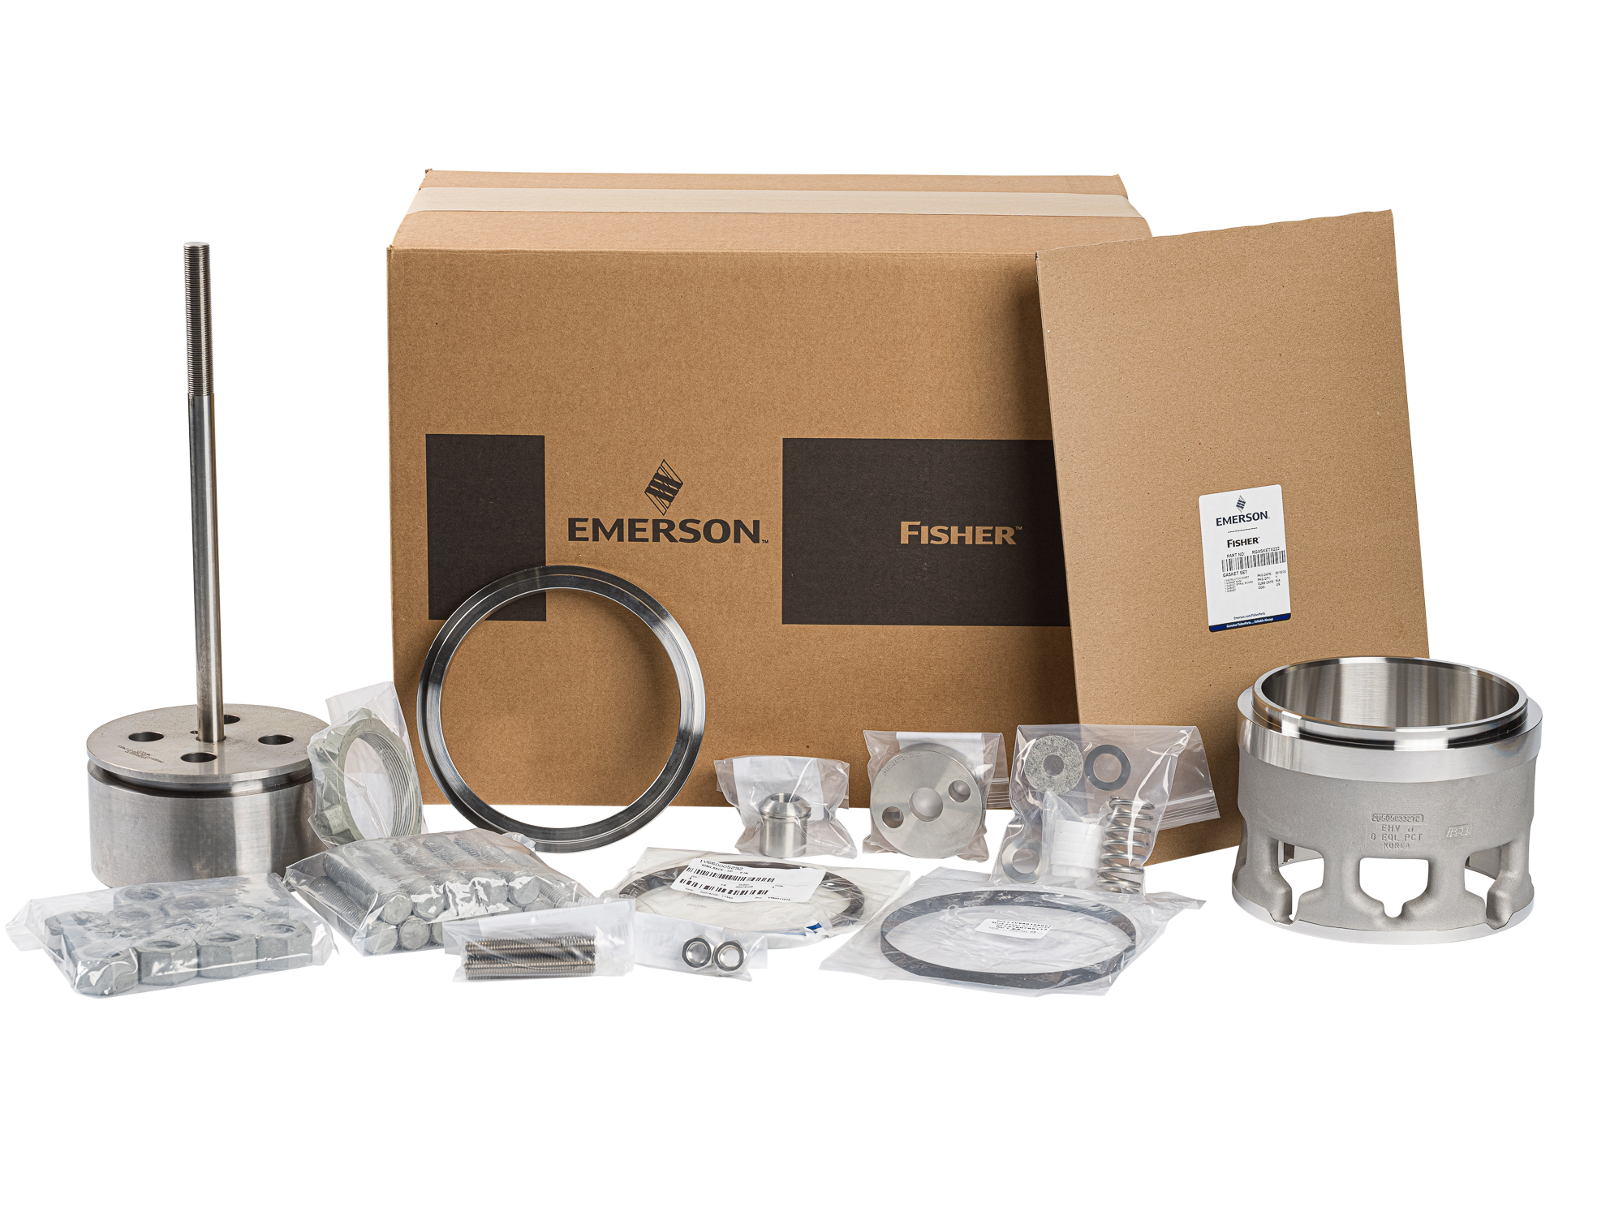
Control Valve Assembly Maintenance Recommendations Guide
Recommended Spare Parts for Customer Self Inventory
Customers are encouraged to maintain spare part stock for Critical applications and consider lead time for General and Severe Service applications. Along with this chart, it is imperative to follow OEM instruction manuals and use OEM parts to maintain plant safety and reliability.
Mandatory Local Inventory of complete trim sets, soft goods, actuator and instrument spares
Critical Functions – Mission Critical
Essential Functions – Vital
Highly Recommend Local Inventory
Necessary Function – Important
Evaluate Cost / Benefits for Local Inventory
Desirable Functions – Minor
Local Inventory Low Priority – consider soft goods only
We recommend stocking soft parts for Open and Inspect maintenance actions.
Consider holding inventory of full valve assemblies based on criticality of application,
valve size, material and complexity of repair.

Slide 11
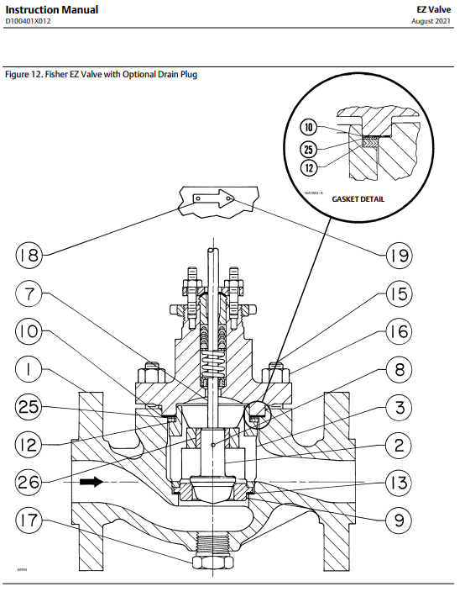
Open And Inspect Process
Refer to the instruction manual for details
We recommend following OEM instruction manuals and use OEM parts to maintain plant safety and reliability
Run as-found diagnostic scan (if applicable)
Pull actuator & bonnet
Soft good replacement (includes packing)
Control valve trim inspection including cage, plug-stem assembly, seat surfaces, gasket and guiding surfaces
Seal ring replacement (soft and metal rings)
Visual inspection of bolting
Packing bore inspection
Validate stem tightness
Visual inspection of body
Block test on actuator
Repair or replace components as needed
Reset bench set (if applicable)
FIELDVUETM re-calibration and run as-left diagnostic scan
Take pictures

Slide 12
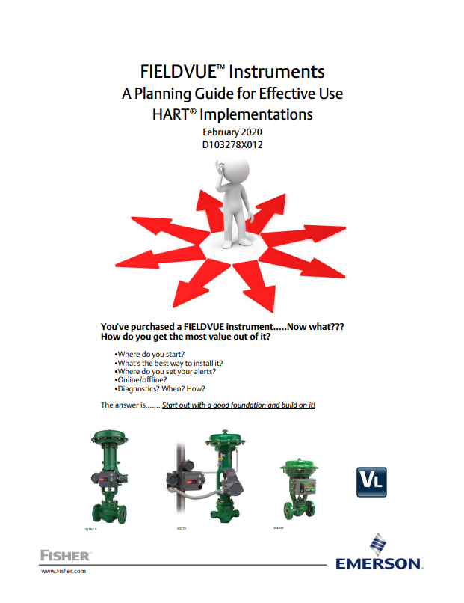
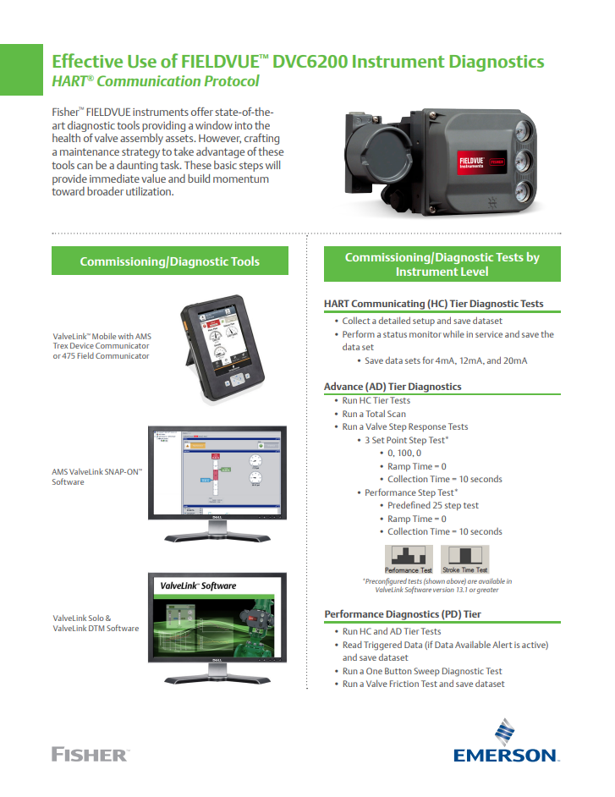
Contacts and References
FisherTM spare parts minimize variability, reduce costs, and support safety by using genuine original equipment manufacturer (OEM) valve, actuator, and regulator spare parts.
Learn more here on the Spare Parts Page
For more details connect with an Emerson sales office at Emerson.com/ContactUs to support your Spare Part needs.
Resources
Guide:
Flyer:
FIELDVUE™ Instruments:
A Planning Guide for Effective
Use HART® Implementations
on effectively using the state-of-the-art diagnostics in your FIELDVUE Instruments.
Effective Use of FIELDVUE™ DVC6200 Instrument Diagnostics HART® Communication Protocol supports basic steps to provide immediate value and build momentum toward
broader utilization.
Click here to read
Click here to read
D353370X012 © 2024, 2025 Emerson. All rights reserved. The Emerson logo is a trademark and service mark of Emerson Electric Co. Fisher and FIELDVUE are each a mark of an entity in the Emerson family of businesses.
All other marks are the property of their respective owners. Neither Emerson nor any of its affiliated entities assume responsibility for the selection, use or maintenance of any product. Responsibility for proper selection, use,
and maintenance of any product remains solely with the purchaser and end user. The contents of this publication are presented for informational purposes only, and while every effort has been made to ensure their accuracy,
they are not to be construed as warranties or guarantees, express or implied, regarding the products or services described herein or their use or applicability. All sales are governed by our terms and conditions, which are
available upon request. We reserve the right to modify or improve the designs or specifications of such products at any time without notice. July 2025

