Slide 1


Welcome
Thanks for joining the Emerson virtual media briefing. We will begin at 0830 CDT / 1330 GMT

Slide 2
TODAY’S BRIEFING How Advanced Automation Ensures Integrity Across the Carbon Capture Value Chain
Emerson Virtual Media Briefing – September 13, 2023

Slide 3
Media Briefing Logistics
RECORDING
CHAT
Q&A
We’re recording the session. Every registrant will receive a recording link.
45-minute presentation
Q&A to follow
Q&A begins after the presentation.
Either submit via chat anytime
Or click on “raise your hand” during Q&A
When Q&A starts, I’ll unmute you to ask your question.

Slide 4
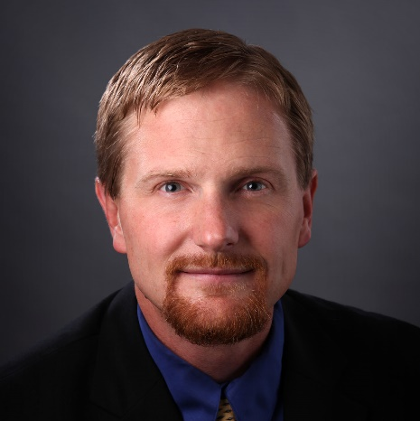
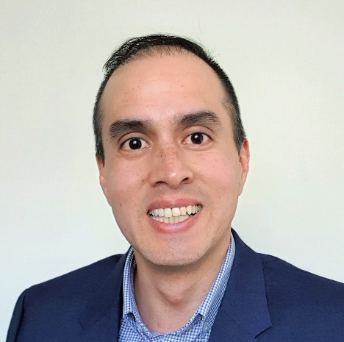


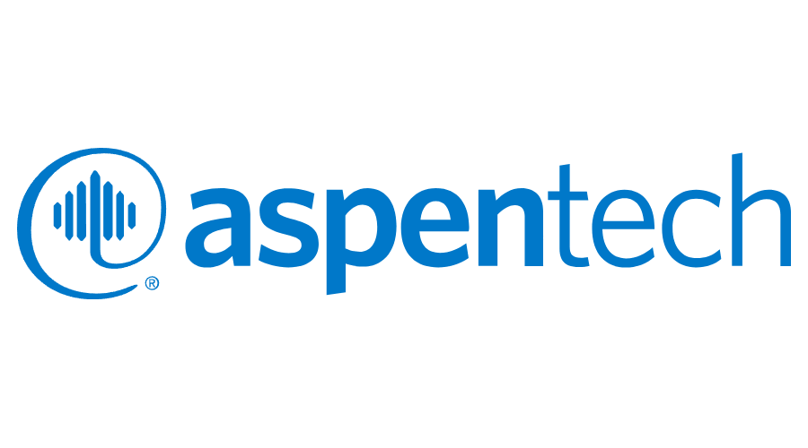
Emerson Virtual Media Briefing Series: Sustainability
How Advanced Automation Ensures Integrity Across the Carbon Capture Value Chain
Providing media with insights about how automation helps industries achieve their sustainability and decarbonization goals
PAST MEDIA BRIEFINGS
SETH HARRIS
Director of Sustainability, Americas
GERARDO MUÑOZ
Sr. Solutions Marketing Manager
Renewable Biofuels
Hydrogen Value Chain
Notes:
Can we match the backgrounds at all?

Slide 5
Emerson’s Environmental Sustainability Framework
GREENING OF
How we improve our internal environmental sustainability performance.
GREENING BY
How we support and enable our customers’ decarbonization and environmental sustainability efforts.
GREENING WITH
How we foster collaboration among stakeholders.

Slide 6


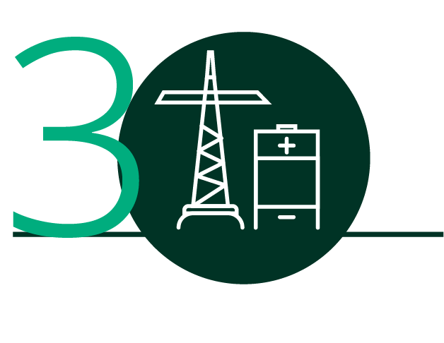
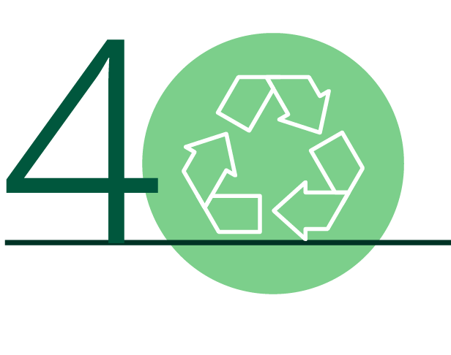
Emerson’s Greening By Priorities
ENERGY SOURCE DECARBONIZATION
ENERGY & EMISSIONS MANAGEMENT
ELECTRIFICATION & GRID SYSTEMS
CIRCULARITY & WASTE REDUCTION
Low-carbon power (solar, wind, hydro, nuclear, biomass)
Low carbon fuels (biofuels, biogas, LNG)
Hydrogen & hydrogen-based fuels
Emissions monitoring & control
Carbon capture, utilization, storage & removal
Advanced controls, analytics & simulation
Smart grid & network management
Energy transport & storage
Workforce safety & productivity
Critical minerals value chains
New molecules production (Bio-based materials
Materials & minerals recycling & circulation
Water & waste management
Emerson 2022 ESG Report

Slide 7
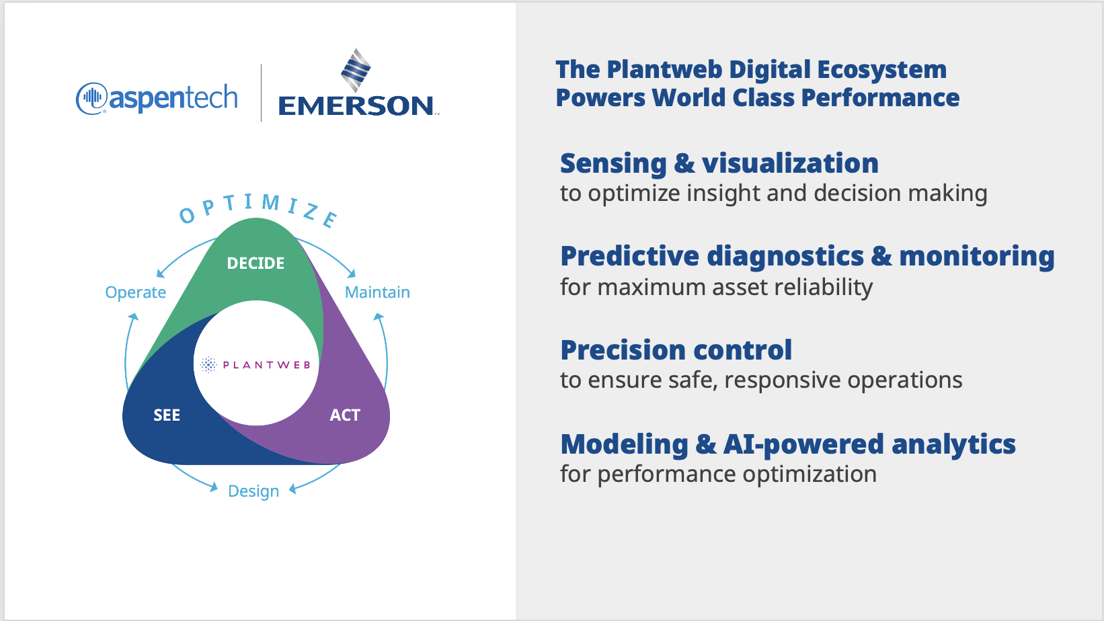

Slide 8
TODAY’S BRIEFING How Advanced Automation Ensures Integrity Across the Carbon Capture Value Chain

Slide 9
CCS/CCUS Offers Viable Role in Meeting Net Zero Targets
Carbon capture represents an estimated 15% of total CO₂ reductions by 2070
Carbon capture at a point source has a dramatically higher concentration of CO_{2;} However, direct air capture is a way to remove existing emissions
Direct Air Capture
Point Source Capture
CCUS
Source: IEA

Slide 10
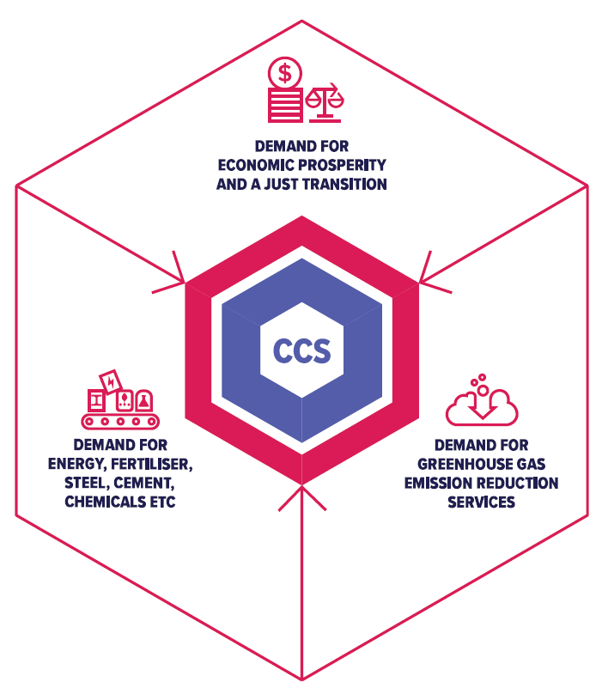



Advanced CCS: Nexus of Demand, Investment and Adoption
CHALLENGES
ACCELERATORS
Cost per Sector
Public Policy
DEMAND FOR ECONOMIC PROSPERITY & A JUST TRANSITION
High CO₂ concentration
Taxes & Incentives
DEMAND FOR ENERGY, FERTILIZER, STEEL, CEMENT, CHEMICALS, etc.
DEMAND FOR GHG EMISSIONS REDUCTION SERVICES
Low CO₂ concentration
Technology
Source: Global CCS Institute
Notes:
Match style and colors to overall theme.

Slide 11

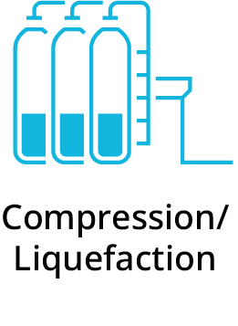
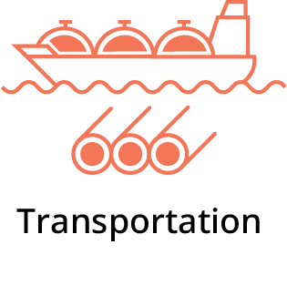

Simultaneous Progress Across Value Chain Necessary to Accelerate CCS Adoption
BUSINESS OBJECTIVE
Separate and purify complex toxic gas to yield high purity CO₂.
Efficiently compress or liquify CO₂ to the ideal, stable state for transport.
Safely carry condensed and liquefied CO₂ to storage or utilization sites.
Indefinitely and safely secure CO₂ at maximum capacity.
TOP OPERATING CHALLENGES
High Energy Cost
Equipment Reliability
Transportation Performance
Safe Injection & Containment

Slide 12
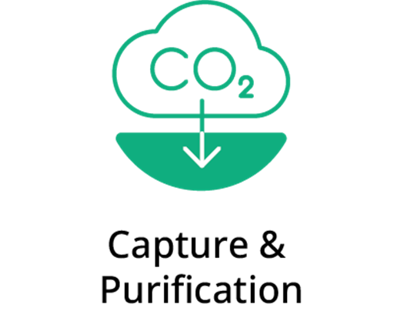
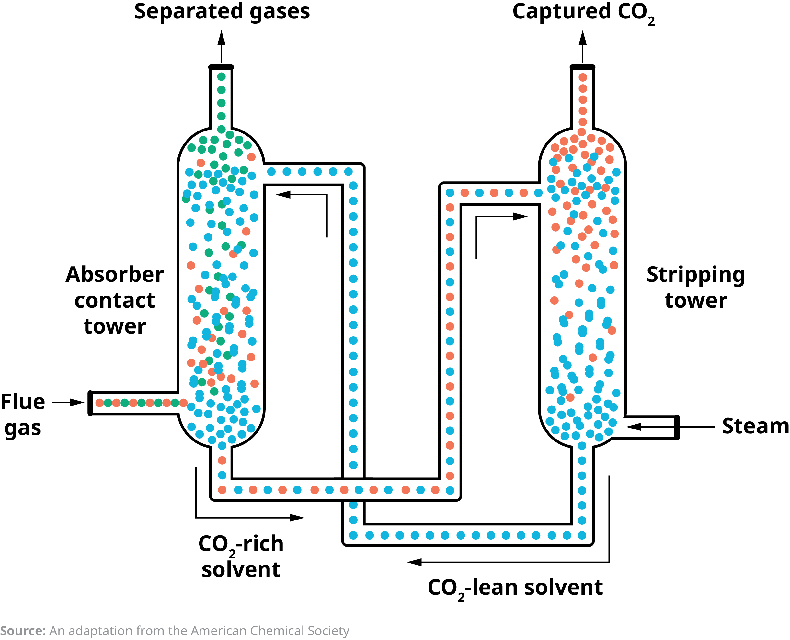
Capture & Purification: Process Overview
Post-combustion Capture Process Overview
Flue gas from plant desulfurized.
Flue gas rises in absorber. Solvent drops down as CO₂ binds to the solvent.
Rich solvent is heated in the heat exchanger using steam energy.
Stripper separates solvent from CO₂.
Lean solvent is recycled and sent back to absorber.
Pure CO₂ is captured.
Separate and purify complex toxic gas to yield high purity CO₂.

Slide 13
Capture & Purification: An Energy Intensive Set of Processes
HOW TO ACHIEVE COST INTEGRITY
Inefficient process performance due to poor design, asset failure or process variability
Variable CO₂ feedstock causes poor capture rate, excess processing
Short-lived filtration media due to overuse
Inefficient, unstable steam production
Heat exchanger fouling, freezing or plugging causing heat losses
Streamlining engineering
and process design
Reduce pre-treatment consumption
Increasing efficiency
of heat transfer
Business Objective
Separate and purify complex toxic gas to yield high purity CO₂.
Increased reboiler efficiency
Balancing capture
rate vs. energy use
High Energy Cost

Slide 14

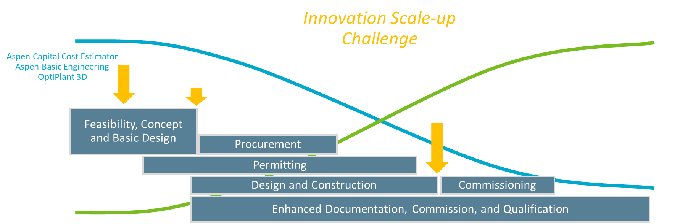

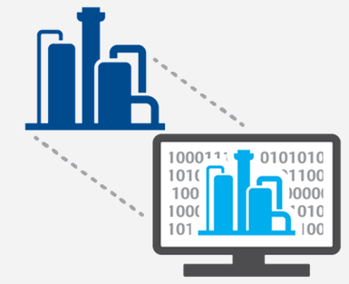
Streamline Process Design
Value Enablers
Operational Challenges
Impact / Outcomes
Costs & efficiency limit project viability and commercialization
Scale-up & system integration require higher costs and risk mitigations
AspenTech Performance Engineering helps to reduce risks & optimize equipment designs, layout and cost.
Increase project viability & support financial decisions with 99% accuracy
Cut design time 50% and execution by 30%
Establish digital foundation for optimum lifetime performance
Ability to Influence Cost
Cash Flow
Total Cost Established
Start-up
Performance incongruencies between process models and real-time conditions
Operators lack first-hand experience and are forced to learn “on the job”
Emerson’s digital twin solutions provide dynamic simulations that model physical environments to give valuable foresight into operations.
Identify and predict issues
Train operators without impacting the running processes
Reduce cost and risk of improving operations

Slide 15
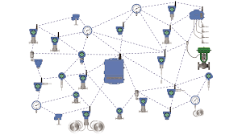
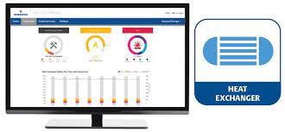
Improve Heat Transfer Efficiency
Value Enablers
Operational Challenges
Impact / Outcomes
Reduced throughput from inefficient heat transfer can hinder overall plant capacity and higher energy costs
Captured CO₂ rework due to off-spec product
Emerson’s portfolio of wireless devices provide a complete picture of heat transfer process performance.
Identify process inefficiencies / issues earlier with pervasive sensing
Real-time data prevents off-spec product and rework
Operational decisions to identify and correct root-cause of performance deviations can be complex and time consuming to identify
Increased/unplanned downtime negatively impact overall carbon capture
Missed emission reduction targets
Emerson’s Plantweb Insight Heat Exchange application provides in-depth monitoring for shell and tube heat exchangers.
Reliable, predictive diagnostics based on first principles give foresight to address operational issues
Reduced energy costs
Uptime is optimized to meet environmental goals and maximize revenue

Slide 16
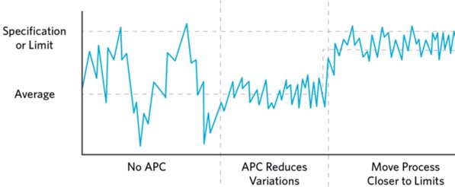

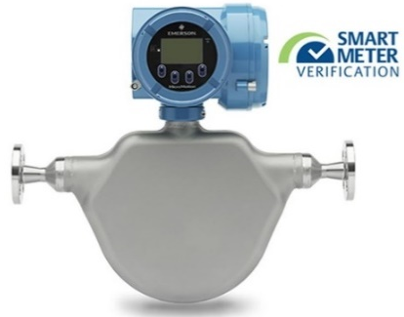
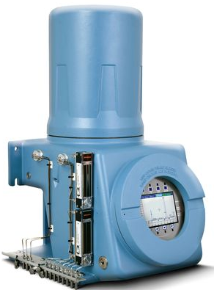
Balance Capture Rate and Energy Use
Value Enablers
Operational Challenges
Impact / Outcomes
Feedstock flow rate can vary dramatically
Plant operations are intertwined
Operational deviations are not intuitive to manage
Sequential processes in the capture process interact in complex ways
Emerson’s DeltaV control system is enhanced by AspenTech adaptive and predictive advanced process or state-based control.
10% reduction in energy consumption
>50% improved overall stability of carbon capture process
No APC
Stabilize
Optimise
Incoming gas composition can vary dramatically
Fluid concentration measurements are not easily obtainable
Capture operations need to adjust as close to “real-time” as possible
Emerson’s line of gas analyzers and density instruments provide precise results to optimize the entire capture process.
Reduced response time from gas analyses enables tighter optimization of capture processes
Real-time concentration monitoring provides advance warning in solvent regeneration / recharging

Slide 17
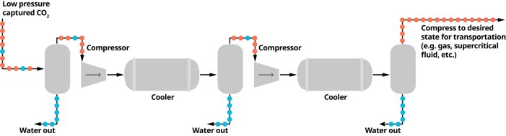
Compression & Liquefaction: Process Overview
Liquefaction Process
CO₂ moves through a series of compressors, or compressor train, to increase pressure.
Intercoolers lower the CO2 temperature prior to the next stage of compression and to condense out the water or other contaminants.
Fluid exits compression clean of contaminants, including water, and in the proper state for transport.
Efficiently compress or liquify CO₂ to the ideal, stable state for transport.​

Slide 18
Compression & Liquefaction: Preparing CO₂ for Transportation
HOW TO ACHIEVE EQUIPMENT INTEGRITY
“Run to failure” reactive maintenance strategies
Poor visibility to wear and tear on critical assets (pumps, compressors, etc.)
Nature of process contributes to accelerated corrosion
Equipment performance can create CO₂ phase instability (liquid vs. solid vs. gas)
Monitor rotating equipment
Implement preventative & predictive maintenance
Lessen impact
of corrosion
Business Objective
Efficiently compress or liquify CO₂ to the ideal, stable state for transport.
Equipment Reliability

Slide 19
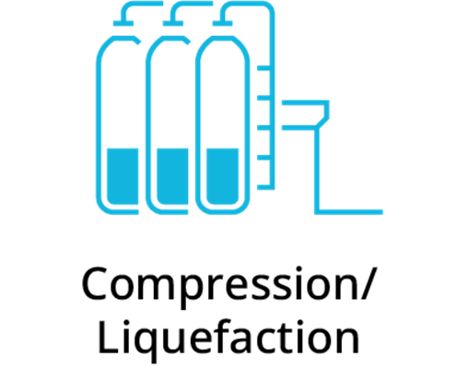
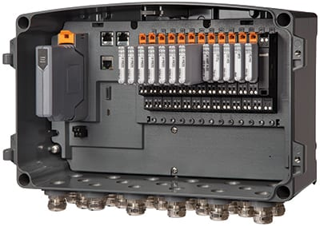
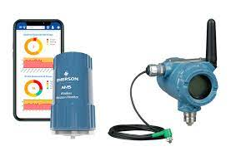
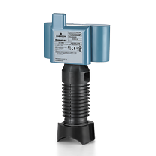
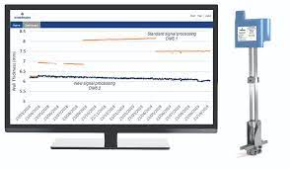
Rotating Equipment and Corrosion Monitoring
Value Enablers
Operational Challenges
Impact / Outcomes
Complex, multi-stage process is challenging to control
Fluid instability may exacerbate mechanical stresses
Emerson’s suite of vibration monitoring hardware and software provide real-time monitoring and analysis to prevent failures on critical equipment
Vibration analytics take the guess work out of predicting failures
Reduce installed cost and enhanced monitoring / analytics for remote assets
Heightened awareness for safe operations when operating at high pressures
Pressure containment risks can go unnoticed until failure occurs
Emerson’s inline and external corrosion monitoring solutions provide early detection of safety or containment risks
Increased safety thru early detection of potential pipe or vessel failures
Reduced risk of captured gas leaking into atmosphere

Slide 20
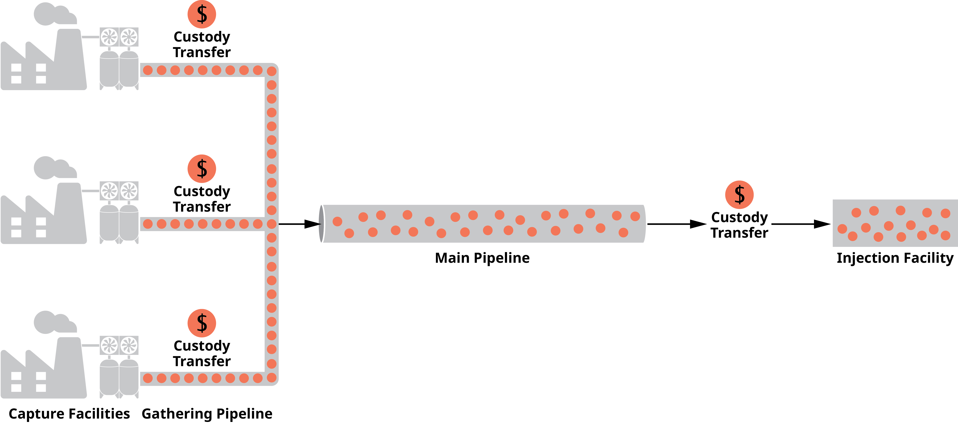
Transportation: Process Overview
Transportation Process
Transport stable CO2 in the desired state for accurate custody transfer and fiscal measurement.
Continuously monitor pipeline and associated asset health and performance.
Efficiently manage wide area operations with real-time monitoring and control to avoid safety events, product contamination, leaks, spills, product loss and false alarms.
Safely carry condensed and liquefied CO₂ to storage or utilization sites.

Slide 21
Transportation: Product & Measurement Integrity
HOW TO ACHIEVE PRODUCT INTEGRITY
CO₂ can solidify due to temperature and pressure fluctuations
Pipeline inefficiencies restrict flow, reduce capacity
Over- or under-pressurization compromises product integrity
Undetected corrosion leads to ruptures and contaminants
Inaccurate custody transfer compromises measurements for financial transaction and transparent regulatory reporting
Maintain ideal CO₂ state
Enable custody transfer
Business Objective
Safely carry condensed and liquefied CO₂ to storage or utilization sites.
Transportation Performance

Slide 22
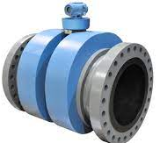
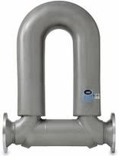
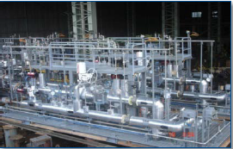
Custody Transfer Measurement
Value Enablers
Operational Challenges
Impact / Outcomes
Fluid phase changes can cause inaccurate flow measurement
Flow range requirements can vary dramatically seasonally and asset to asset
Emerson’s suite of flow measurement equipment provide flexibility to accurately and repeatably measure CO₂
Flow meter diagnostics alert to process disruptions and prevent measurement inaccuracies
Accurate measurement across a wide-range of flow rates
Measurement accuracy and validation is paramount as the “cash register” for transactions between two parties
Multiple skids can cause integration irregularities for CO₂ measurement points
Emerson’s engineered flow measurement systems provide turnkey solutions for accurate, verifiable measurement of CO₂
Engineered systems ensure confidence in financial transactions
Turnkey solution ensures system interoperability from design to startup and long-term operations

Slide 23
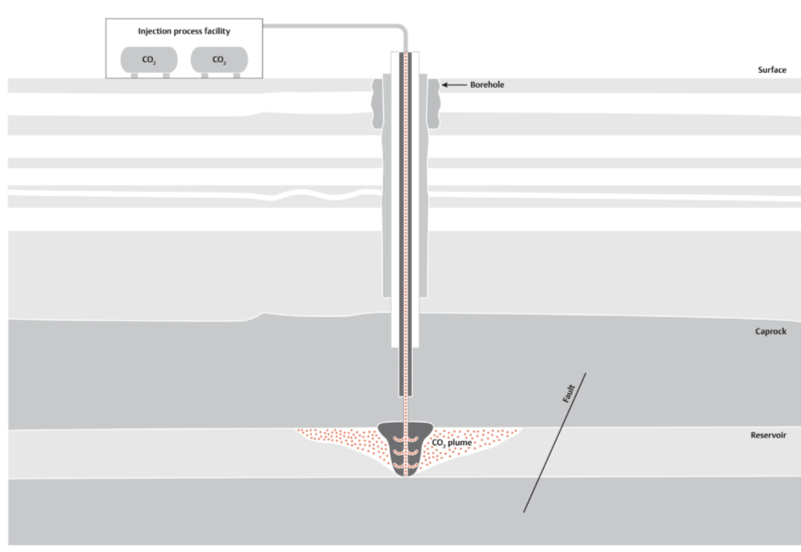
Geological Storage: Process Overview
Geological Storage Process Overview
Study geological candidate sites and begin exploration permitting.
Interpret seismic and well data to select storage location.
Prove long-term CO₂ containment and minimal impact of operations.
Obtain regulatory approvals.
Develop the storage field and engineer drilling/injection project.
Begin safe injection of CO₂ and monitor operations.
Track CO₂ underground displacement over time to ensure permanent geological storage and report to stakeholders.
Indefinitely and safely secure CO₂ at maximum capacity.

Slide 24
Geological Storage: Performance Integrity
HOW TO ACHIEVE PERFORMANCE INTEGRITY
Compromised physical security of geological formation due to faults, fractures, or improperly sealed wells
Environmental damage and safety risks due to leakage
Induced seismicity, or earthquakes, due to inaccurate volumes of CO₂ injection
Inability to secure government permits due to incomplete and/or inaccurate characterization of the reservoir
Increased risks from leakage pathways, pressure build up and induced seismicity due to inability to predict CO₂ plume behavior
Assessing geological storage characterization
Custody transfer
Monitoring and
controlling injection
Business Objective
Indefinitely and safely secure CO₂ at maximum capacity.
Tank gauging and management
Safe Injection & Containment

Slide 25
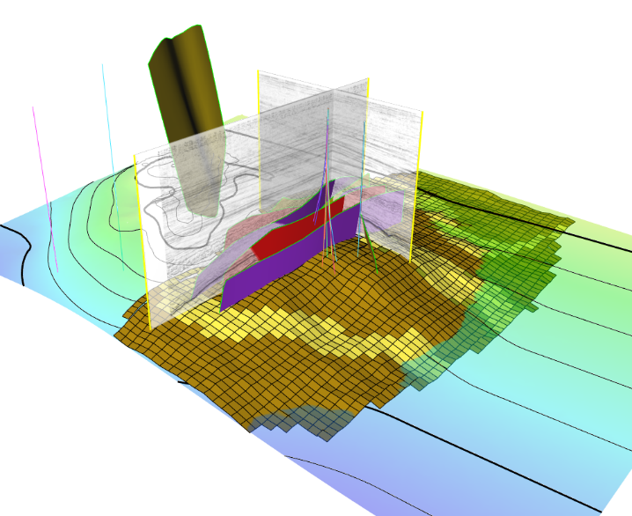


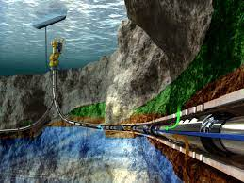
Assess and Monitor Geological Characteristics
Value Enablers
Operational Challenges
Impact / Outcomes
Site selection is highly dependent on geology
High risks & uncertainties with CO₂ geological storage across lifecycle
AspenTech’s Subsurface Science & Engineering software assesses storage capacity, injectivity and containment for successful carbon storage projects.
Confidently select locations and support permit applications
Engineer projects to de-risk geological storage and maximize CO₂ volume
Ensure a safe and permanent carbon storage over time.
Downhole pressure and temperature are inferred in many cases
Variance in formation properties can lead poor operational decisions
Roxar Downhole Pressure & Temperature Gauges provide accurate, precise, real-time measurements are crucial to reservoir operations
Operational decisions are based on real-time measurements
Continuous monitoring provides valuable data for increased well integrity over the life of operations
Notes:
Monitor during and after injection
for safe and long-term containment of CO₂
Storage capacity, injectivity and containment
AspenTech Subsurface Science & Engineering solutions enable storage site characterization, screening & selection, injection & flow modeling.
AspenTech SSE - Geological Storage Characterization
Role: Geophysicists, Petrophysicists, Geologists & Reservoir engineers
Challenge: Storage site selection is highly dependent on the geological characteristics of an area
Benefit: Select storage locations, engineer storage projects & support permit applications
How you overcome the challenge to achieve the benefit: Subsurface analytical, modeling and simulation for site characterization, screening and selection, and storage development planning.
Interpret subsurface data such as seismic and well information to get a good understanding of the geology & increase confidence in containment integrity
Build a 3D model to support decisions regarding the storage complex suitability and development
Design drilling and injection with optimal project costs and operating conditions to safely store the CO₂ without compromising the subsurface
AspenTech SSE - Injection Optimization
Role: Reservoir engineers
Challenge: High risks associated with geological storage of CO₂
Benefit: De-risk injection of CO₂ for safe storage in the geological formation
How you overcome the challenge to achieve the benefit: Injection modeling and evaluation of CO₂ flow in the rock over a period of time, to optimize across design of injection strategies to operations.
Simulate injection of CO₂ and resulting CO₂ diffusion through the reservoir over time.
Model how the gas is predicted to continue to migrate and diffuse after the injection period has finished.
Design the overall injection strategy and facilities, and optimize the injection operations to ensure injection efficiency, safety, and project success.

Slide 26
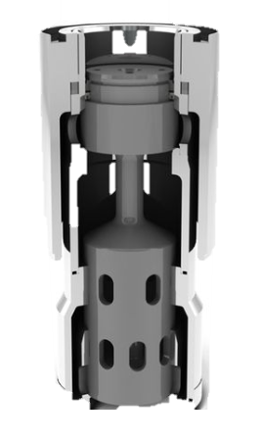
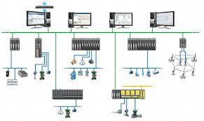
Monitor and Control Injection Facility
Value Enablers
Operational Challenges
Impact / Outcomes
Extreme operating conditions cause excessive wear and tear on equipment
Fluid properties require tighter control to maintain injection rates and integrity from surface to permanent storage
Emerson’s complete line of severe service valves ensure reliable operations in the toughest of applications
Selecting the correct control valve prevents leaks and reduces the risk for safety incidents
Tight flow control for liquefied / supercritical CO₂ protects the process even during process excursions
Poor performance or unplanned downtime will have ripple effects on upstream operations
Complex system dynamics are challenging for an operator to quickly and safely act upon
Emerson’s DeltaV advanced process control solutions ensures safe operations with visibility to mitigate negative impacts to surface or subsurface operations.
Precise, reliable control of surface equipment reduces failures from complex subsurface operations
Integration with simulation and engineering software provide confidence for operational decisions

Slide 27
CCS is at the Nexus of Opportunity to Achieve Our Decarbonization Goals
BUSINESS OBJECTIVE
Separate and purify complex toxic gas to yield high purity CO₂.
Efficiently compress or liquify CO₂ to the ideal, stable state for transport.
Safely carry condensed and liquefied CO₂ to storage or utilization sites.
Indefinitely and safely secure CO₂ at maximum capacity.
TOP OPERATING CHALLENGES
High Energy Cost
Equipment Reliability
Transportation Performance
Safe Injection & Containment
Notes:
How can I work in data management?

Slide 28
How Advanced Automation Ensures Integrity Across the CCS Value Chain Virtual Media Briefing
Question & Answer
CHAT
Submit your question via chat anytime
Click “raise your hand” during Q&A to be unmuted
OR

